Slide 1
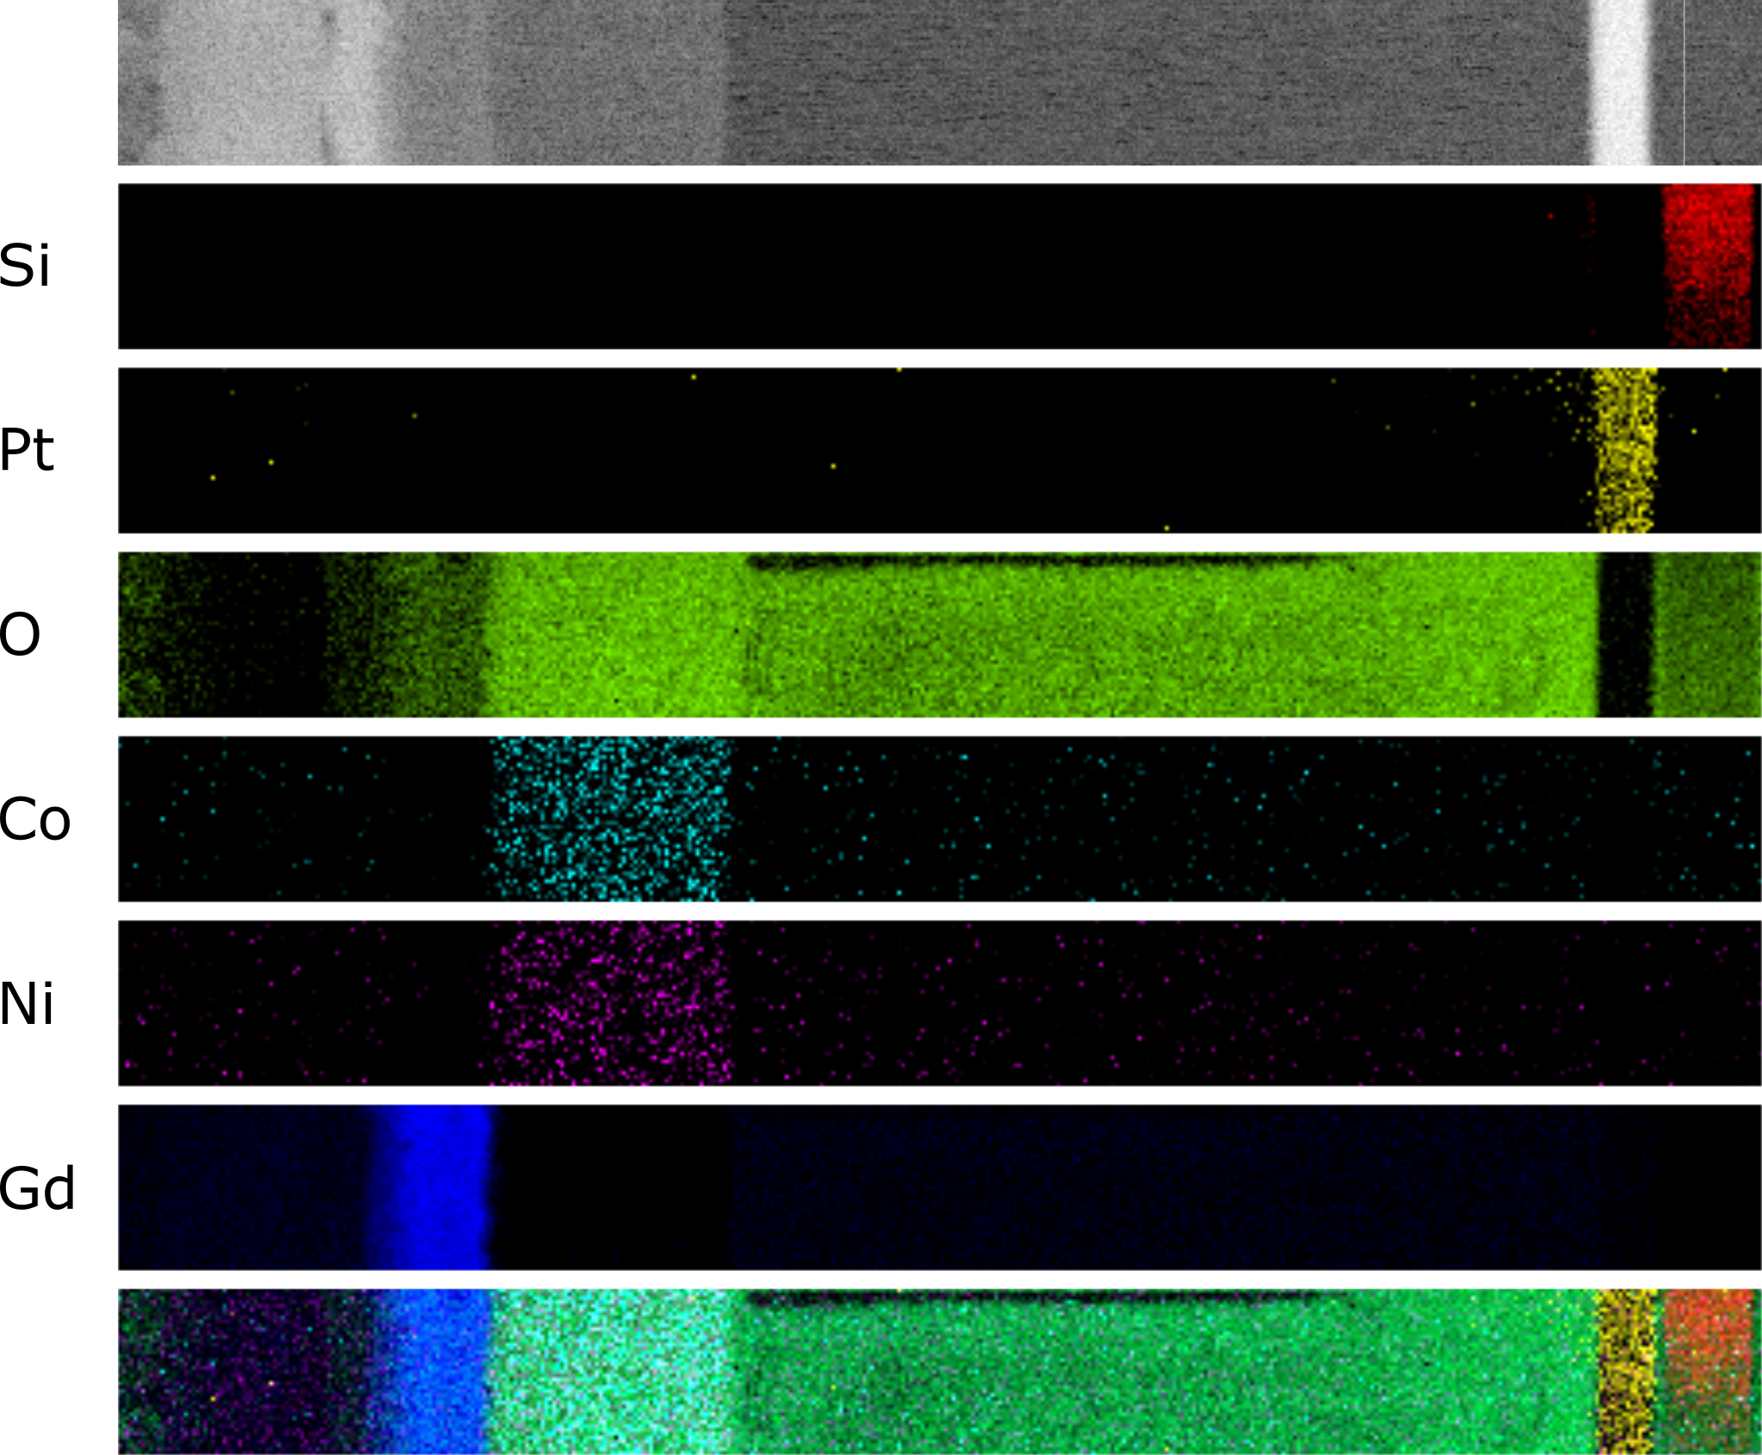
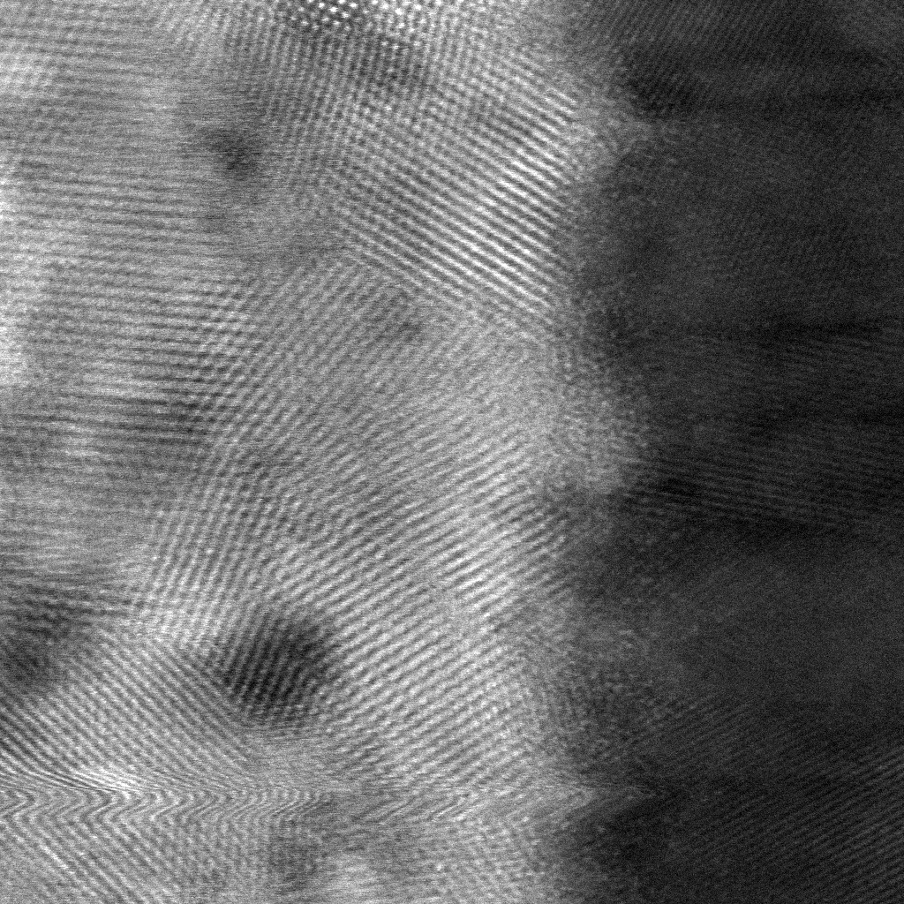
AG
size = _____ nm
size = _____ nm
Junwei, please fill in the blank lines with the size of the imaged region. I’ll add scale bars once I know how big each of these images is.

Slide 2
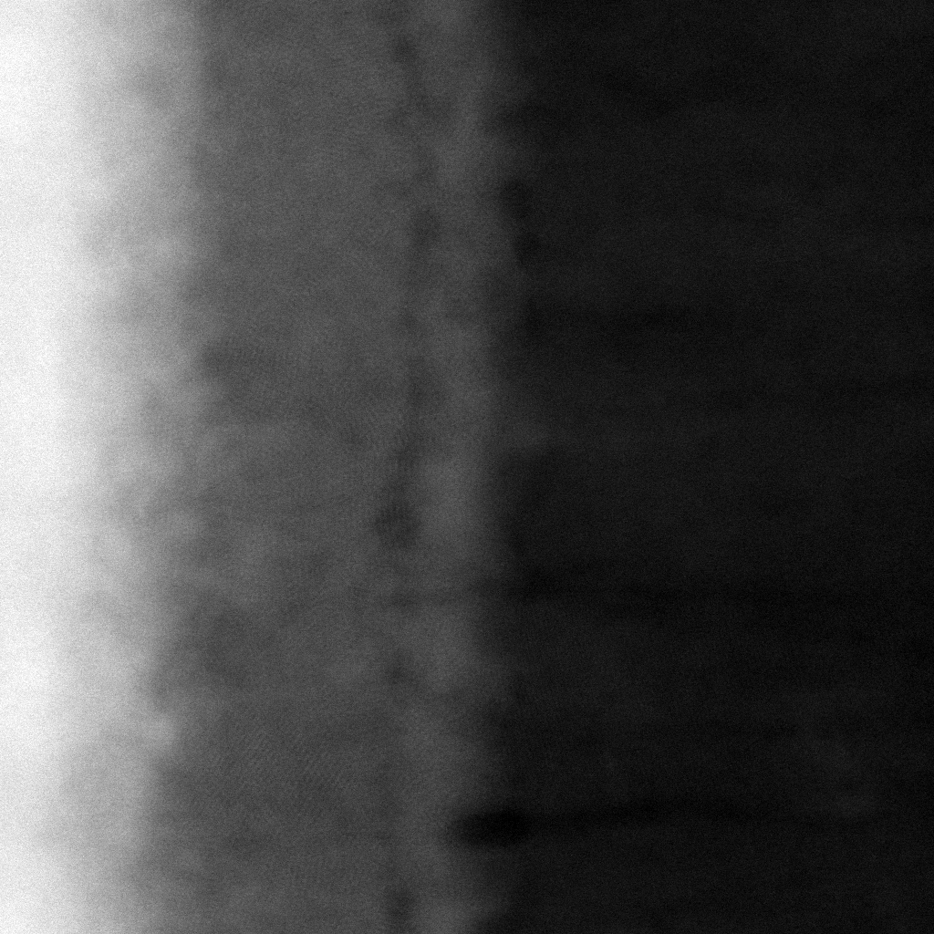
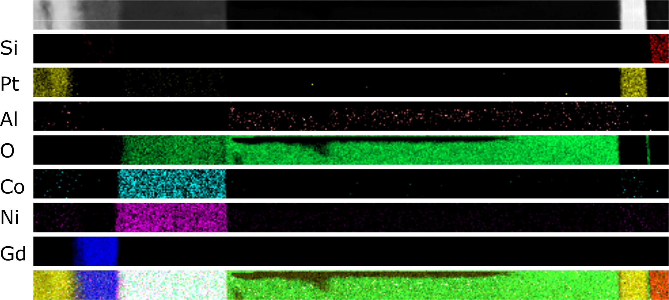
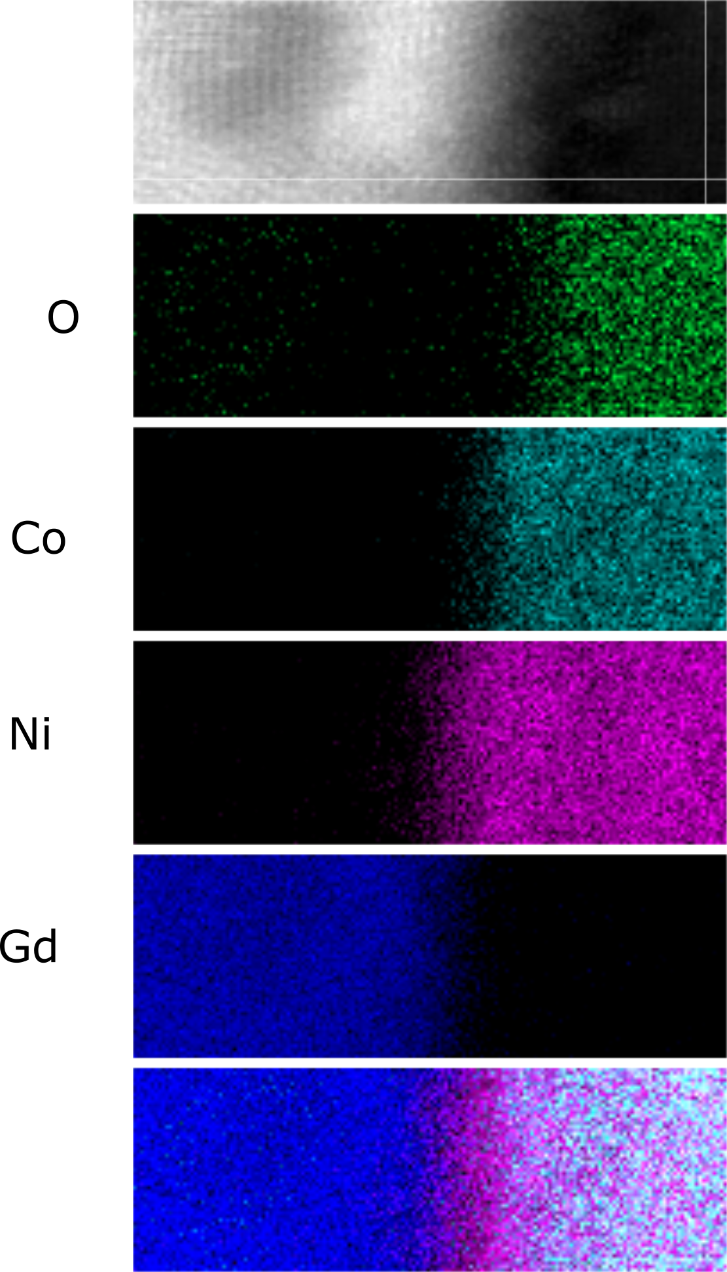
FC
size = _____ nm
size = _____ nm
size = _____ nm

Slide 3
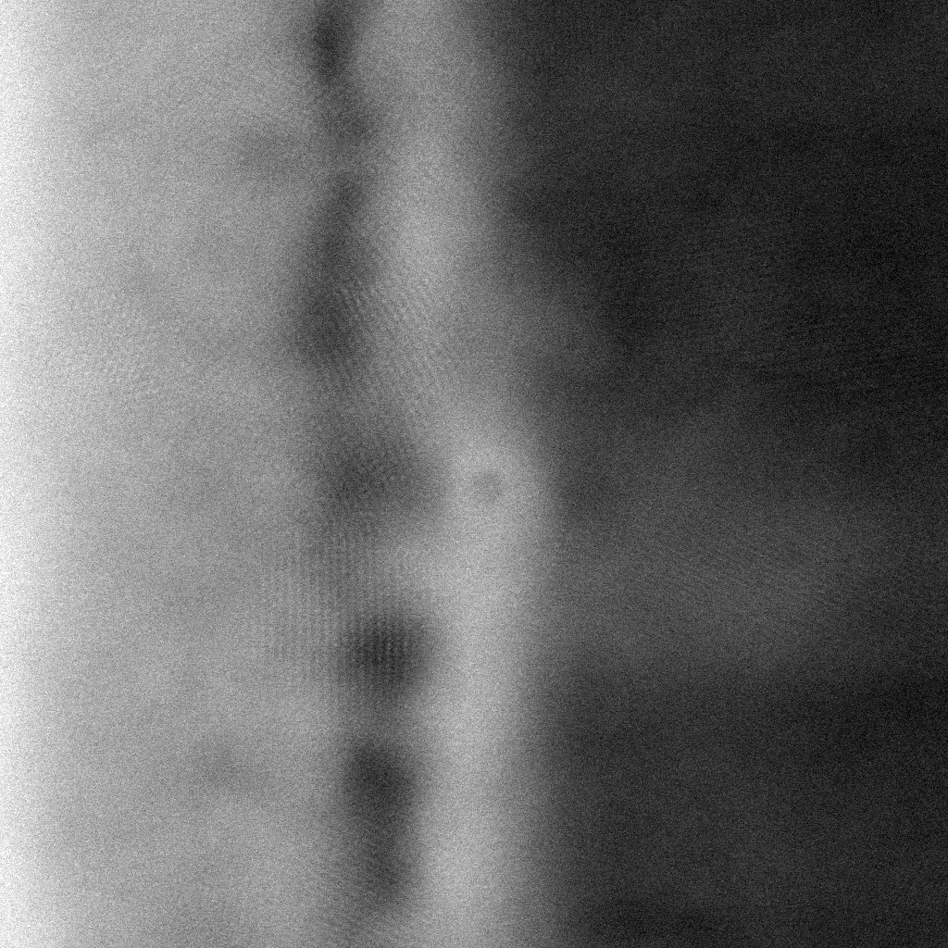
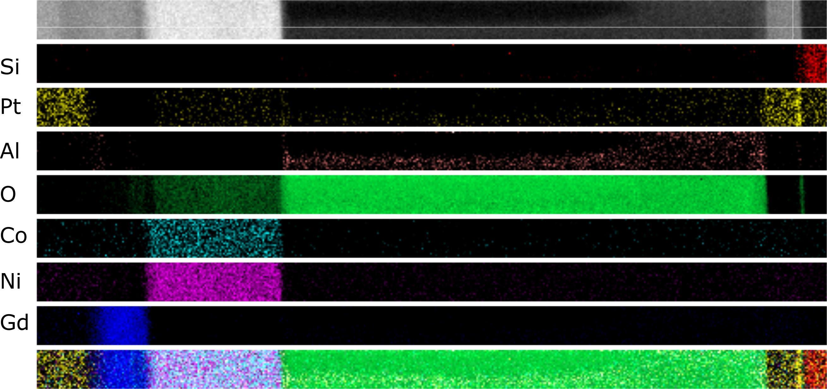
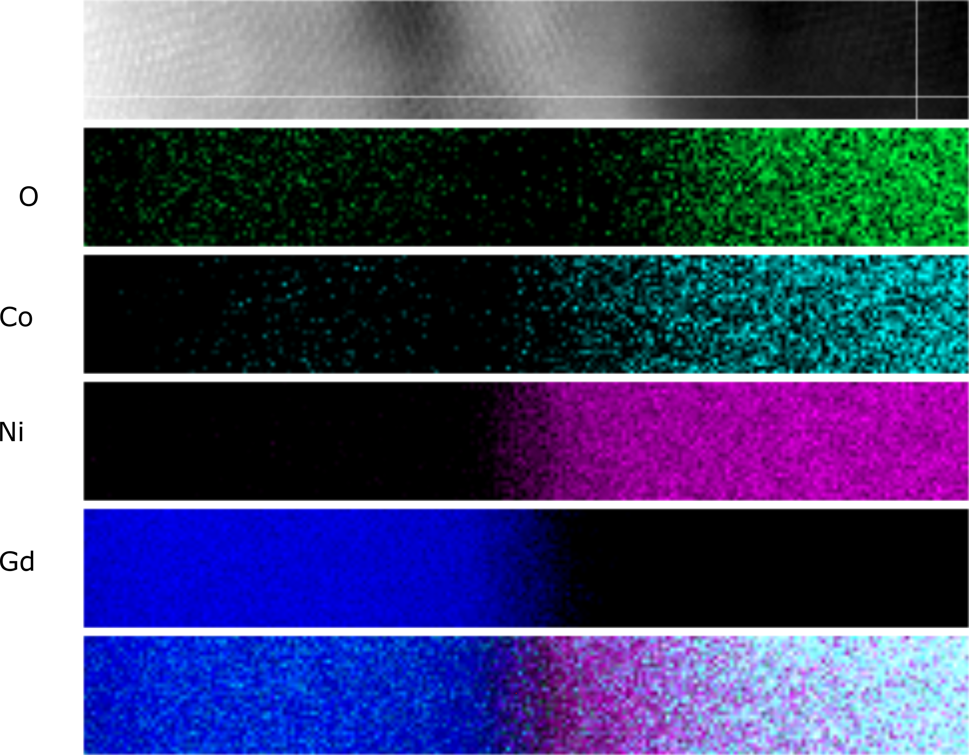
FCVC
size = _____ nm
size = _____ nm
size = _____ nm

